Slide 1

Real Time Tweet Monitoring
Utsav Soni | Anushree Badola | Kusumbor Bordoloi | Kashi Ram Yadav

Slide 2

Contents
Introduction
Libraries Used
Methodology
Results
Conclusion
References

Slide 3
Objectives
To provide an interface for real time web visualization of Tweets relating to a specific keyword

Slide 4
Libraries Used
Javascript Libraries Used:
Leaflet.JS
JQuery
APIs Used:
Twitter REST API

Slide 5

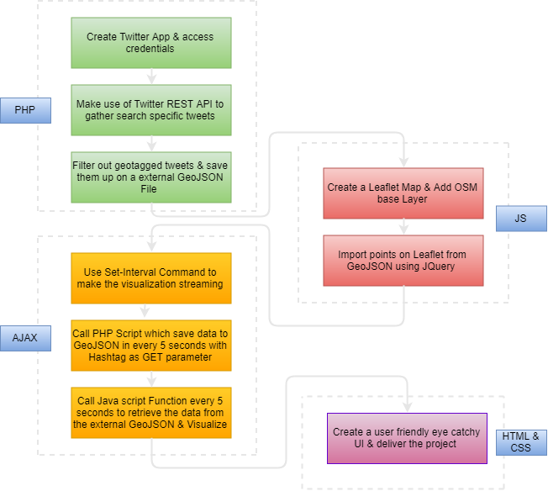
Methodology

Slide 6
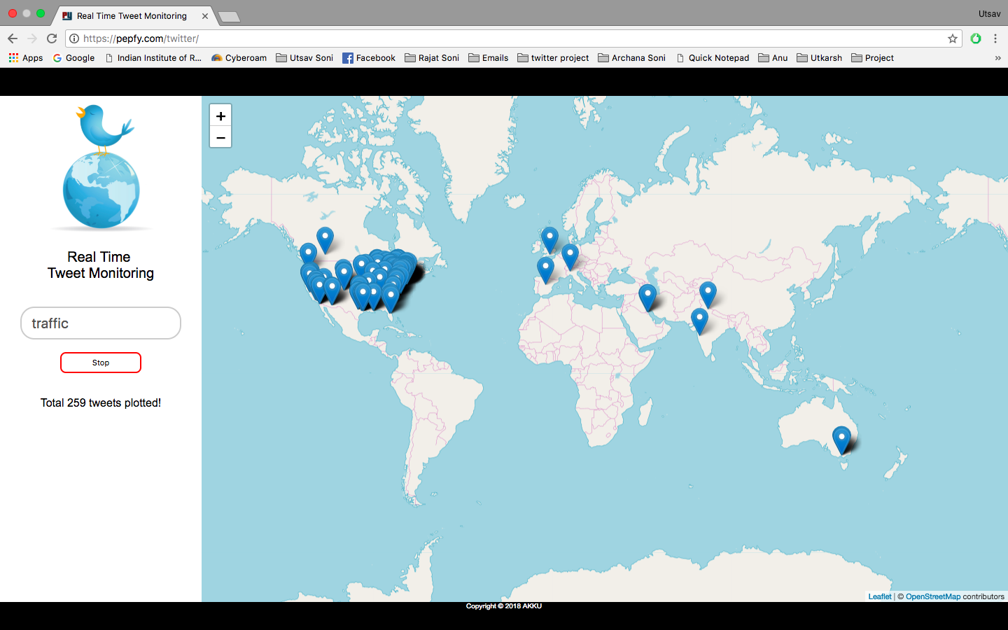
Results

Slide 7
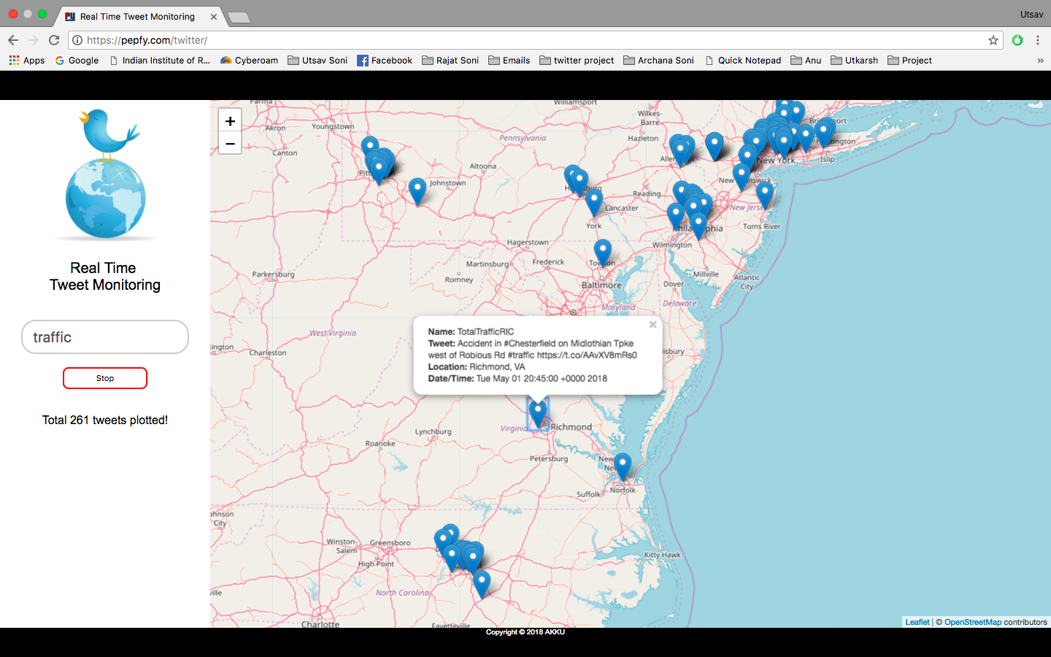
Results

Slide 8
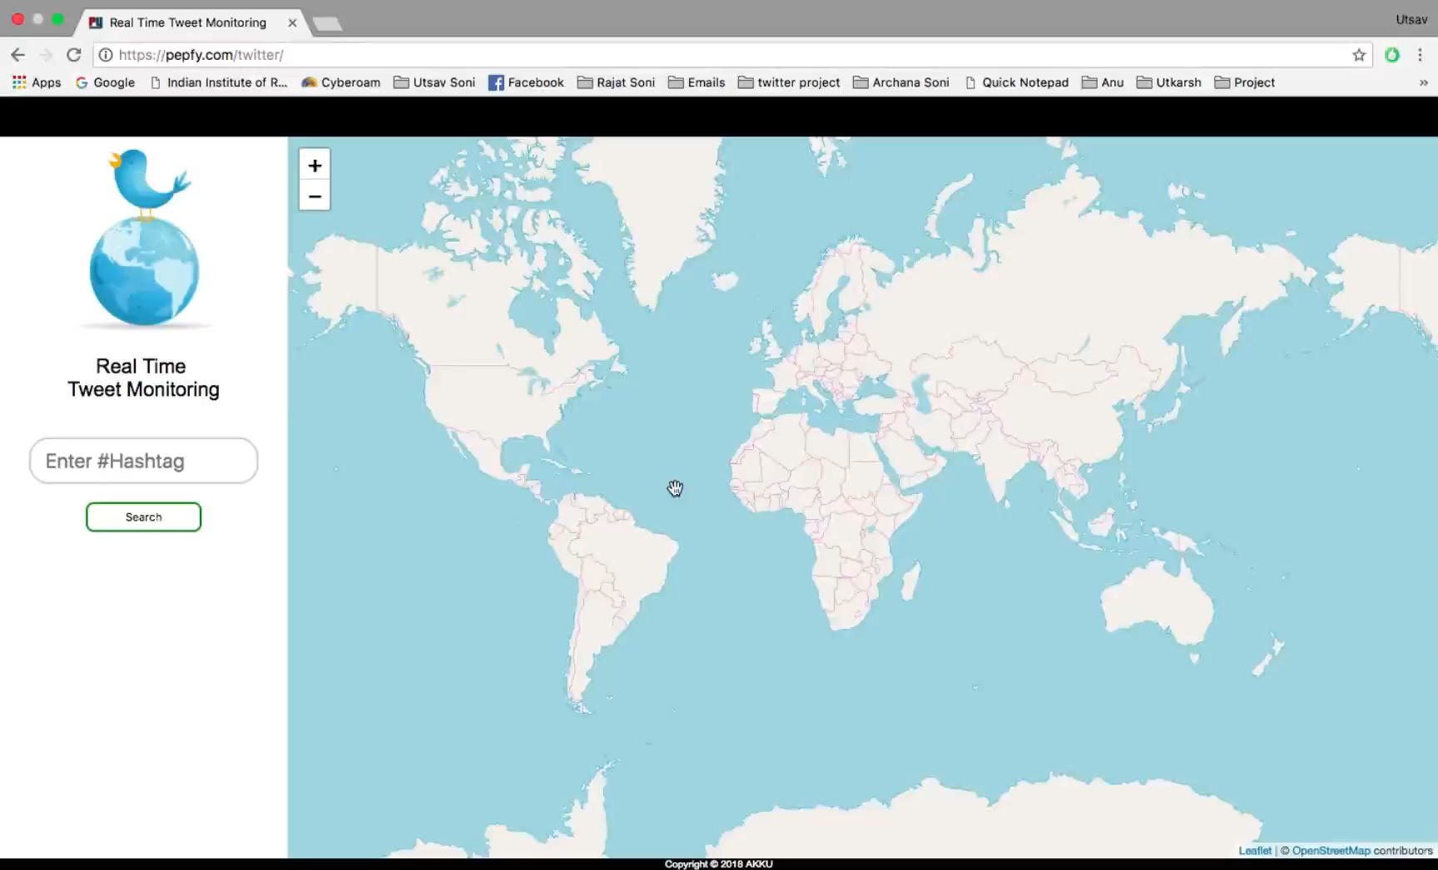
Results

Slide 9
Conclusion
It is possible to extract tweet data by using Twitter PHP REST API
REST API provides data in JSON format
We learnt the usage of HTML, CSS, JavaScript, PHP and AJAX.
We got familiar with Leaflet.js and JQuery library.

Slide 10
References
https://onemilliontweetmap.com/
https://iag.me/socialmedia/build-your-first-twitter-app-using-php-in-8-easy-steps/
https://developer.twitter.com/en/docs/tweets/search/api-reference/get-search-tweets.html
https://medium.com/@maptastik/loading-external-geojson-a-nother-way-to-do-it-with-jquery-c72ae3b41c01
http://leafletjs.com/examples/geojson/
http://www.encodedna.com/jquery/read-json-file-push-data-into-array-and-convert-to-html-table-using-jquery.htm

Slide 11
THANK YOU

